Slide 1
Please make sure there’s a “Module Transition” slide for every module
02 | Web API Basic Design
Jeremy Likness | Principal Architect
Christopher Harrison | Content Developer

Slide 2
Module Overview
Please leave this area blank to allow for picture in picture recording
Defining the Resource
Verbs and Web API
Content Negotiation
Tools for Testing (Fiddler, PostMan)
Consuming a REST API using jQuery

Slide 3
Defining the Resource
Please leave this area blank to allow for picture in picture recording
Collection or Singleton: /widgets or /widgets/1
Navigation: /widgets/1/things or /widgets/1/things/1
Nouns
“Target of a hypertext reference”
Avoid exposing business logic, i.e. if a process requires orchestration across multiple resources, make the process the noun
In Web API, a resource is typically a controller

Slide 4
Resource Examples (Twitter)
Please leave this area blank to allow for picture in picture recording
Users
Statuses
User_timeline
Home_timeline
Retweets_of_me
Retweets
Retweeters
Followers
Trends

Slide 5
Resource Examples (Azure API Mgmt.)
Please leave this area blank to allow for picture in picture recording
/apis
/apis/1/operation
/apis/1/policy
/authorizationServers
/certificates
/products
/users
/users/1/subscriptions
Etc.

Slide 6
Verbs and Web API
Please leave this area blank to allow for picture in picture recording
GET – “read”
POST – “insert” (collection)
PUT – “replace”
DELETE – “remove”
PATCH – “update”
Custom (proceed with caution)

Slide 7
Practical example: Account Transfer
Please leave this area blank to allow for picture in picture recording
/accounts
How do I transfer $5 from /accounts/1 to /accounts/2?
Attempt #1:
Deduct $5 by PUT /accounts/1
Add $5 by PUT /accounts/2
Problems:
Too much business knowledge
No transfer id to map back to
Lack of transaction – what happens if it breaks after the deduction?
/accounts
/accounts/1
/accounts/2

Slide 8
Practical example: Account Transfer
Please leave this area blank to allow for picture in picture recording
Attempt #2
Create a transaction under account
POST /accounts/1/transfers { amount: 5, targetAccount: 2 }
Query /accounts/1/transfers/1
Better!
Does /accounts/1 “own” the transaction?
Is it evident that /accounts/2 is impacted?
What if you are navigating /accounts/2 … how do you know a transaction happened?
/accounts
/accounts/1
/transfers

Slide 9
Practical example: Account Transfer
Please leave this area blank to allow for picture in picture recording
Suggestion
The “noun” is the transaction
POST /transactions { src: 1, amount: 5, tgt: 2 }
Query /transactions/srcAccount or transactions/tgtAccount
(reference back up to /accounts/1 and /accounts/2)
Clear spot to navigate from and models that the accounts are “participants” in the transaction
Guess what …
There is no “right” or “perfect” way
/transfers
/transfers/1
/srcAccount
/tgtAccount

Slide 10
Case Study: GitHub API
Please leave this area blank to allow for picture in picture recording
Notes:
https://developer.github.com/v3/ -> start at https://api.github.com/users/jeremylikness and drill down

Slide 11
Content Negotiation
Please leave this area blank to allow for picture in picture recording
Apps consume content in different ways
For example, XML used to be the most popular format
Now of course JSON is most popular
A good service should support multiple content types
A good client will request the favored type
Out of the box, Web API handles provisioning content based on common requests

Slide 12
Content Negotiation
Please leave this area blank to allow for picture in picture recording
Notes:
Show Odata example, but add header Accept application/xml, show result, then change to text/xml and show result

Slide 13
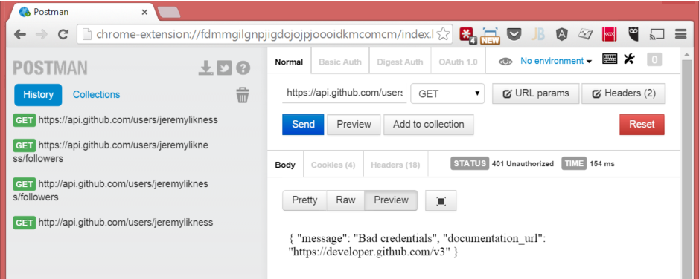
Tools for Testing
Please leave this area blank to allow for picture in picture recording
Postman Chrome extension
http://bit.ly/postmanext
Fiddler by Telerik
http://www.Telerik.com/fiddler

Slide 14
Using Testing Tools
Please leave this area blank to allow for picture in picture recording
Notes:
Send request using PostMan, and capture using Fiddle, then show how to construct (Replay from Composer), change back to json

Slide 15
Consuming a RESTful API with jQuery
Please leave this area blank to allow for picture in picture recording
$.ajax
Verbs (PUT, POST, GET)
URL (resource)
Data
DataType
JSON makes it really, really easy to turn into a JavaScript object

Slide 16
Consuming a RESTful API with jQuery
Please leave this area blank to allow for picture in picture recording
Notes:
http://jsfiddle.net/jeremylikness/e0weyq70/

